Slide 1
CHAPTER 8 | Part 2
Service Innovation and Design

Slide 2
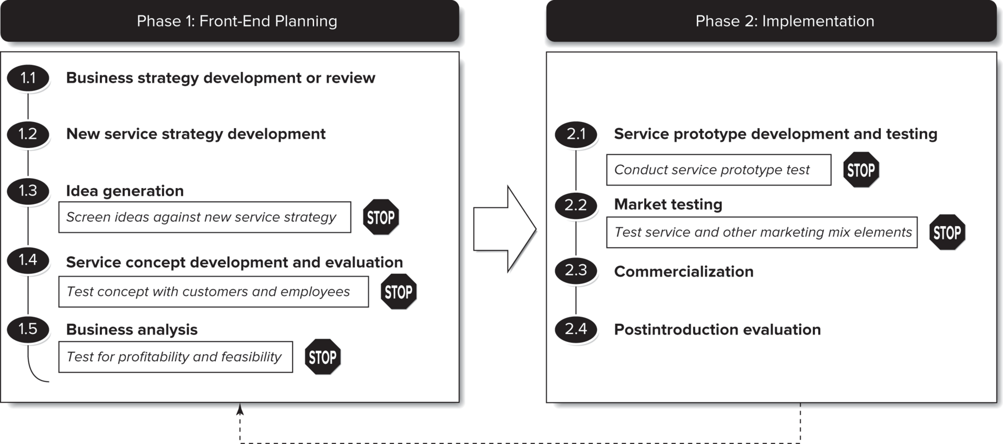
Service Innovation and Development Process
Requirements that a new service must meet before moving to the next stage.
Notes:
The stop signs represent checkpoints that separate the critical stages of the development process. The checkpoints specify requirements that a new service must meet before it can proceed to the next stage of development.
Implementation is different for services.
New service or product development is not always a linear process.

Slide 3
Phase 1: Front-End Planning
Five-step process

Slide 4


Business Strategy Development or Review
The new service strategy and specific new service ideas must fit within the larger strategic mission and vision of the organization.
  What is the mission of the company? (You can usually find this in the tag-line).
  How does this new service fit that mission?

Slide 5
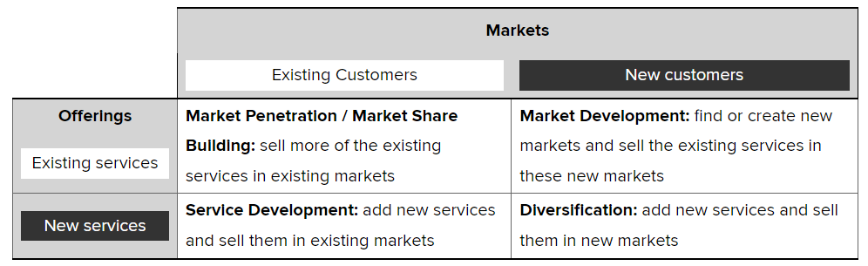
New Service Strategy Development
This framework allows and organization to identify growth opportunities and can be helpful as a catalyst for creative ideas.

Slide 6
Idea Generation
Generate new ideas that can be evaluated in light of the new service strategy screening criteria described in the preceding steps.
Can include collaboration with customers, vendors, even competition.
Observing customers and how they use the firm’s services and products can also elicit creative ideas (empathic design).
There must be some established mechanism for ensuring an ongoing stream of new service possibilities.

Slide 7
Service Concept Development and Evaluation
Drawing pictures and describing an intangible service in concrete terms are difficult, especially if it is co-created in real time with customers (ex. hairdresser).
The phase takes multiple versions until reaching a defined concept.
After clear definition of the concept, a description should be produced that represents its specific characteristics.
  This is called a service design document.
Then, you want to determine initial customer and employee responses to the concept.

Slide 8
Business Analysis
Assuming the new service concept is favorably evaluated:
  Estimate its economic feasibility
  Estimate its potential profit implications
  Develop a demand analysis (who will want the service?)
  Predict revenue projections (how much money will you make?) and how much will it cost
  Assess operational feasibility (what changes will be needed to make this happen? Can your current facility/employees accommodate this new service?)

Slide 9
Phase 1I: Implementation
Four-step process

Slide 10
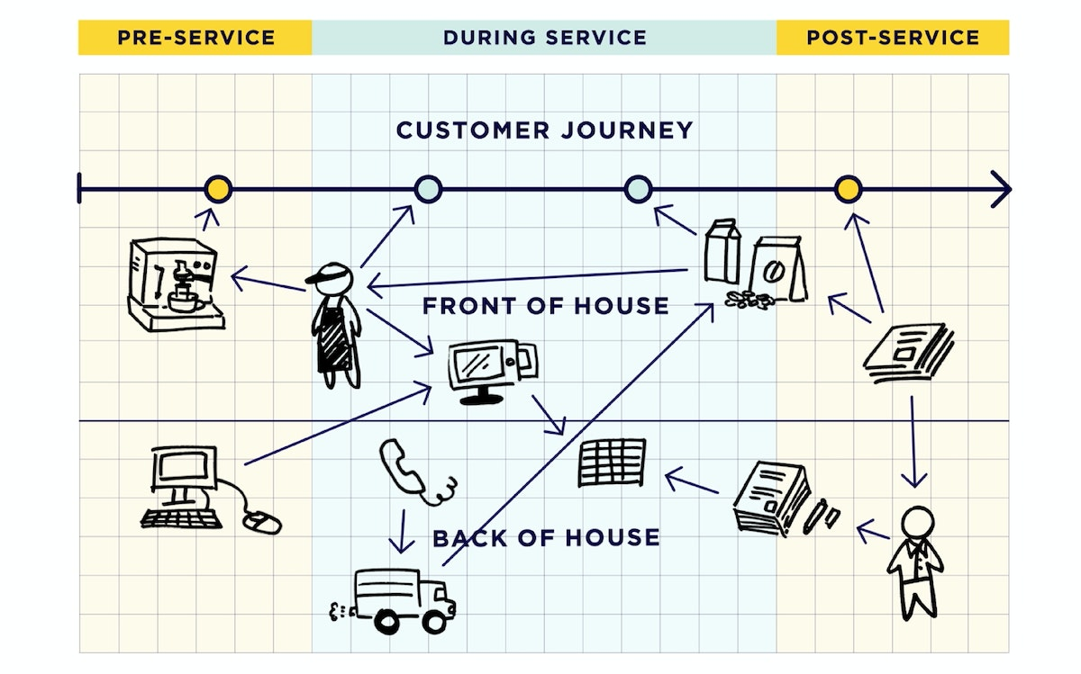
Service Prototype Development and Testing
This step should involve all those who have a stake in the new service: customers, employees, representatives, operations, etc.
This phase produces a detailed blueprint of the customer experience and the implementation plan for the service.
IDEO prototype for Crowne Plaza lobby

Slide 11
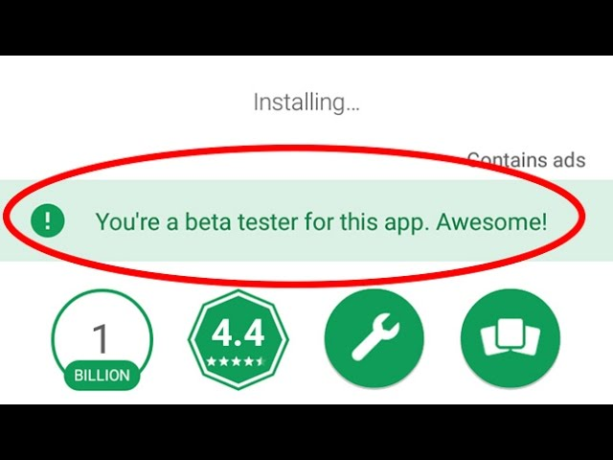
Market Testing
Test the response against the marketing mix variables and distributing system.
Trying to identify an isolated market to test can be challenging so sometimes companies use their employees.
Continual pilot testing is critical!

Slide 12
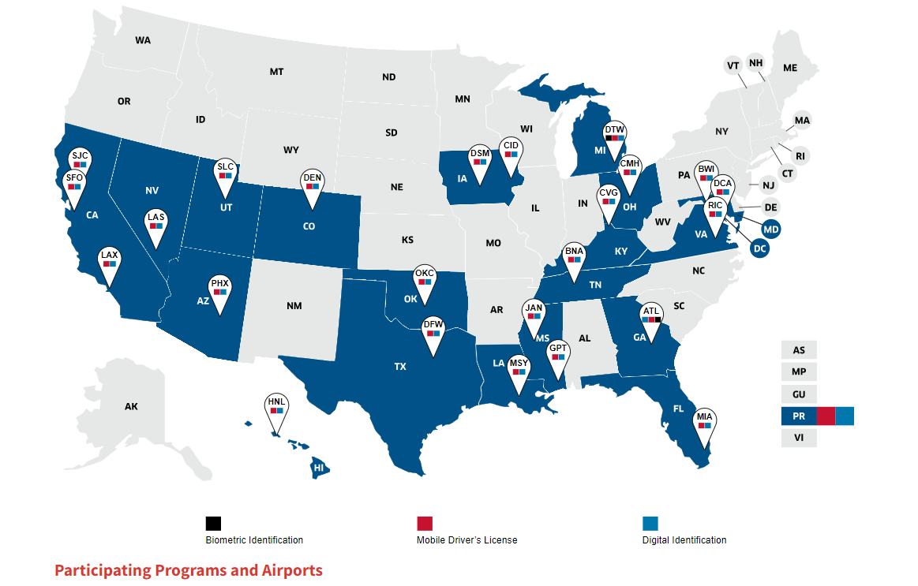
Commercialization
The service is live! This stage has two primary objectives:
  To build and maintain acceptance of the new service among large number of the service delivery personnel who are responsible day-to-day for service quality.
  To monitor all aspects of the service during introduction and through the complete service cycle.

Slide 13
Postintroduction Evaluation
Information gathered during commercialization can be reviewed and refinements are made to the delivery process, staffing, or marketing mix variable.
Formalizing a review process is important for this stage to be effective.
Utilizing the customer’s viewpoint is also critical for this stage to be effective.

Slide 14
Service Blueprinting
A technique for service innovation and design.

Slide 15
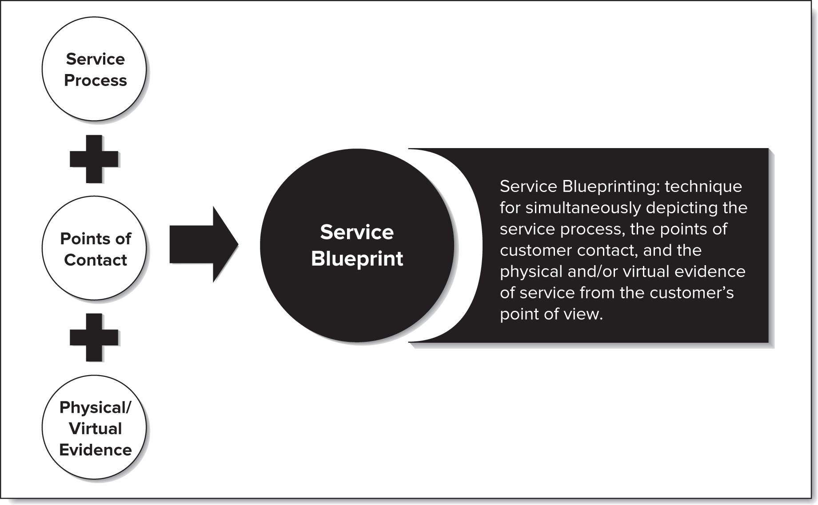
What is a Service Blueprinting?
A service blueprint is a picture or a map that portrays the customer experience and the service system, so that the different people involved in providing the service can understand it objectively.
A service blueprint visually displays the service, breaks it down into its logical components, and depicts the steps or tasks in the process.

Slide 16
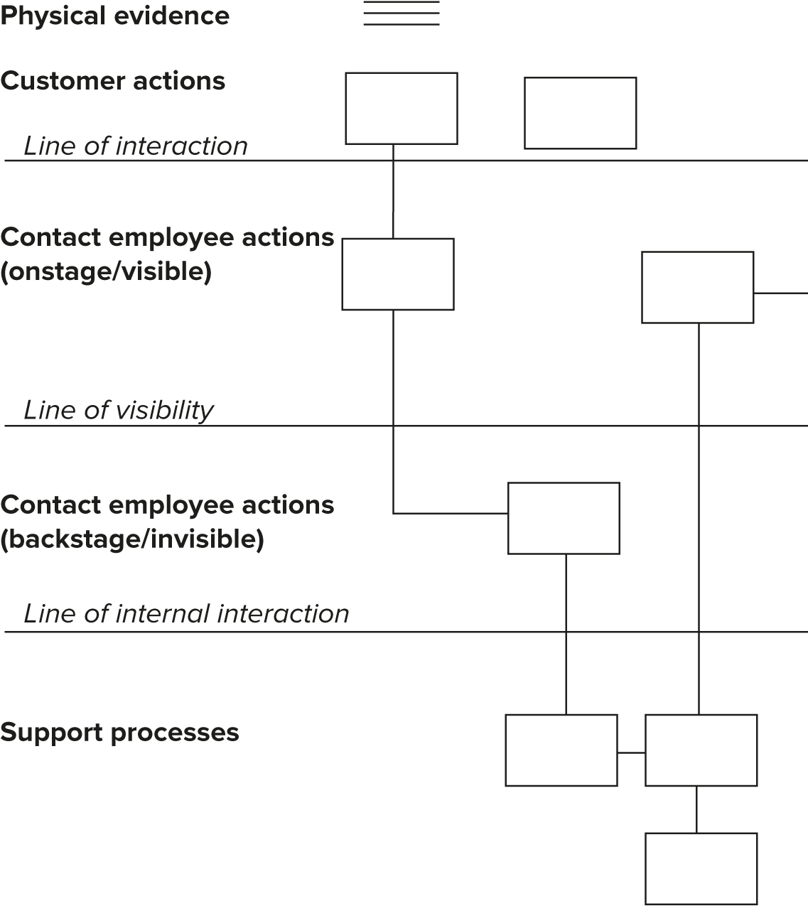
Blueprinting Components
Action Areas:
Customer actions
Onstage/ visible contact employee actions
Backstage/ invisible contact employee actions
Support processes
Physical evidence
Points of Interactions:
Line of interaction
Line of visibility
Line of internal interaction

Slide 17
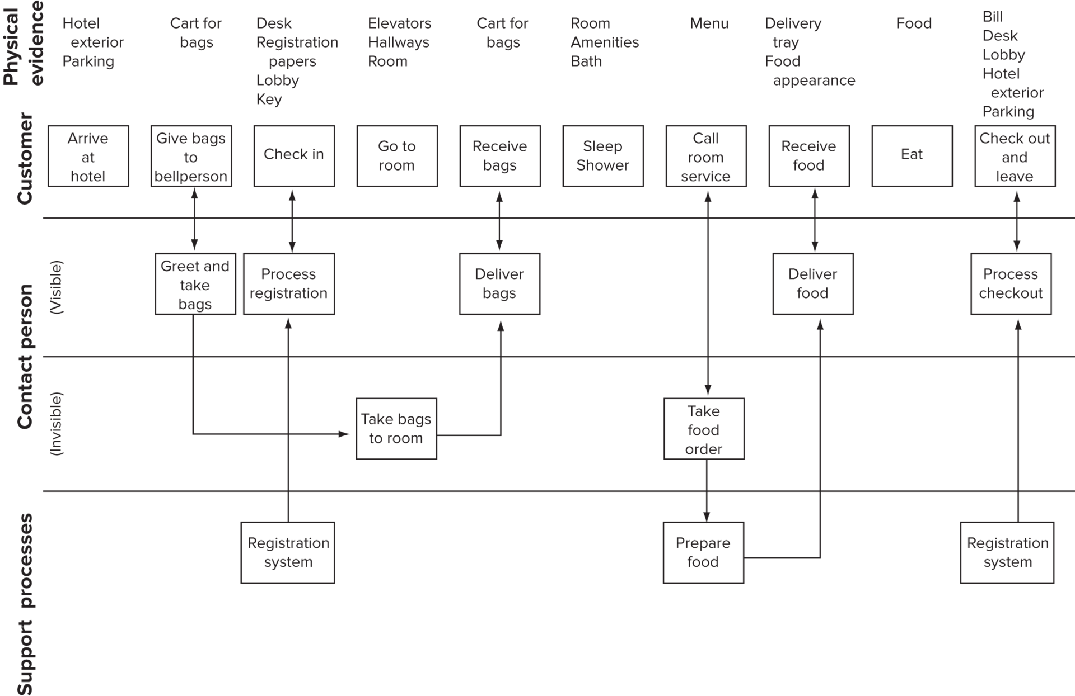
Blueprint for Overnight Hotel Stay Service

Slide 18
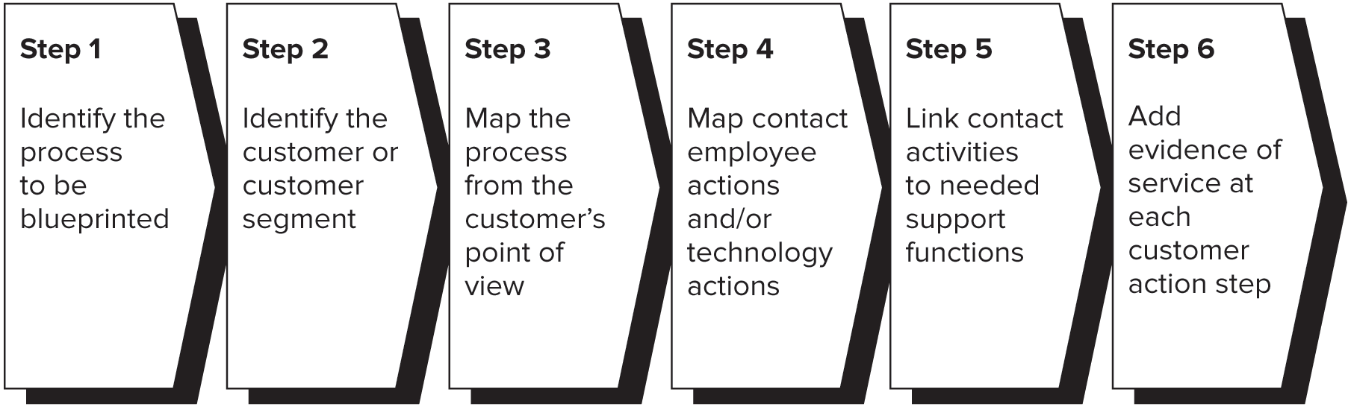
Building a Blueprint
Notes:
2: Different blueprints need to be made for different customer segments
3: Chart the choice and actions that the customer performs or experiences in purchasing, consuming, evaluating the service.
4: Draw lines of interaction and visibility, map process from frontline employee point of view – visible and invisible actions
5: Link internal processes – certain steps may turn out to be unnecessary and can be eliminated

